Slide 1
Querying and Visualizing Protests Through Neo4j’s Temporal Knowledge Graphs
HEXIN LIU
Department of Computer Science
Valparaiso University

Slide 2
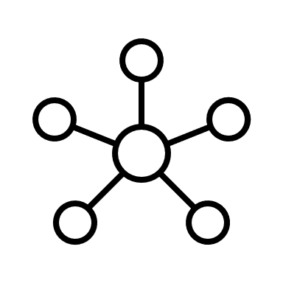
What are Temporal Knowledge Graphs?
Knowledge graphs (KGs) describe the real world with structured facts. A fact consists of two entities and a relation connecting them, which can be formally represented as a triple (head, relation, tail)
Temporal knowledge graphs (TKGs) are the knowledge graphs with temporal information.
Courtesy of Microsoft Stock Images

Slide 3

Motivations and Goal of the Project
Protests are one of the hotbed issues in the sociology camp.
There are a few global datasets dedicated to studying on political demonstration around the world to observe protests.
The TKGs are ideal in visualizing protests and other political events and show the evolution of actions between significant entities.
Goal: we are making visualizations of the relations between entities over time for more manageable study of political events.
Courtesy of Microsoft Stock Images

Slide 4


Programs
First PROGRAM
Second PROGRAM (Google Colab)
Courtesy of Wikimedia
Courtesy of Wikimedia

Slide 5
Step 1 : Minimize the Dataset Rows (Testing)
Dataset: Integrated Crisis Early Warning System (ICEWS)
We first used the ICEWS dataset with reduced rows (for example, an ICEWS dataset with 1,000 rows) in Neo4j software, create queries, and observe the results of our queries.

Slide 6
Step 2 : SSH Tunneling
We then used ssh tunnelling to ensure access to the remote Neo4j server using this command :
“ssh -L localhost:7474:localhost:7474 -L localhost:7687:localhost:7687 ###account”

Slide 7
Step 3: Remote Neo4j Server
We then attempted on loading the whole dataset into the Neo4j server and observing the patterns in the ‘updated’ Neo4j graph through querying.
To make the loading process fast, we created indexes for easing the loading time (Neo4j).

Slide 8
Step 4: Labelling
We then began to create the automatic protest/non-protest labelling in Google Colab.
This labelling can offer any needed reference for human labelers and also helpful insights of the relations between entities.
However, the labelling has disadvantages since the labelling can disregard a row that delves into protests but did not mention the word ‘protest’.

Slide 9
Step 5 : Implementing Labelling Further
We start on experimenting on the word embedding technique.
We input a certain word to the most_similar method of Gensim library to create a list of similar words to the word ‘protest’.
First 50 words similar to ‘protest’: Protests, Protesting, Demonstrations, Protesters, Demonstration, Protested, Demonstrators, Activists, Protestors, Rallies, Opposition, Demanding, Staged, Marches, Angry, Supporters, Denouncing, Strike, Marched, Rally, Boycott, Crackdown, Calling, Demanded, Sparked, Anti, Denounce, Planned, Denounced, Provoked, Petition, Marchers, Thousands, Prompted, Slogans, Riots, Riot, Hundreds, Unrest, Angered, Outrage, Chanting, Prompting, Rioting, Strikes, Banners, Outside, Walkout, Gathered, Massive

Slide 10
Step 5 : Implementing Labelling Further (Continued)
We then implement this list to parse each word in a row for computing the cosine similarity between it and the concerned word from a list of similar words.
We then use the similarity to determine if the event belongs to the protest category or the non-protest category.
If larger or equal to the threshold value, classify the event as protest. If not, classify the event as non-protest.
Currently, the word embedding technique is not fully finished as we have not defined our threshold value to classify each event.

Slide 11
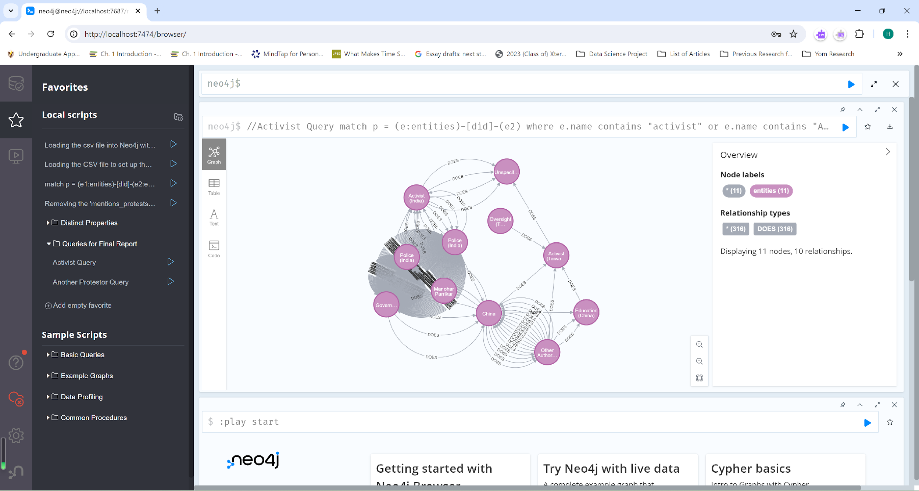
Examples of Findings of the 750,000 Rows-Version
A screenshot of the ‘updated’ Activist Query with all the rows. Note the concentrated relations between the Indian Police/ Indian Government to denote the many interactions between these two entities throughout 2017.

Slide 12
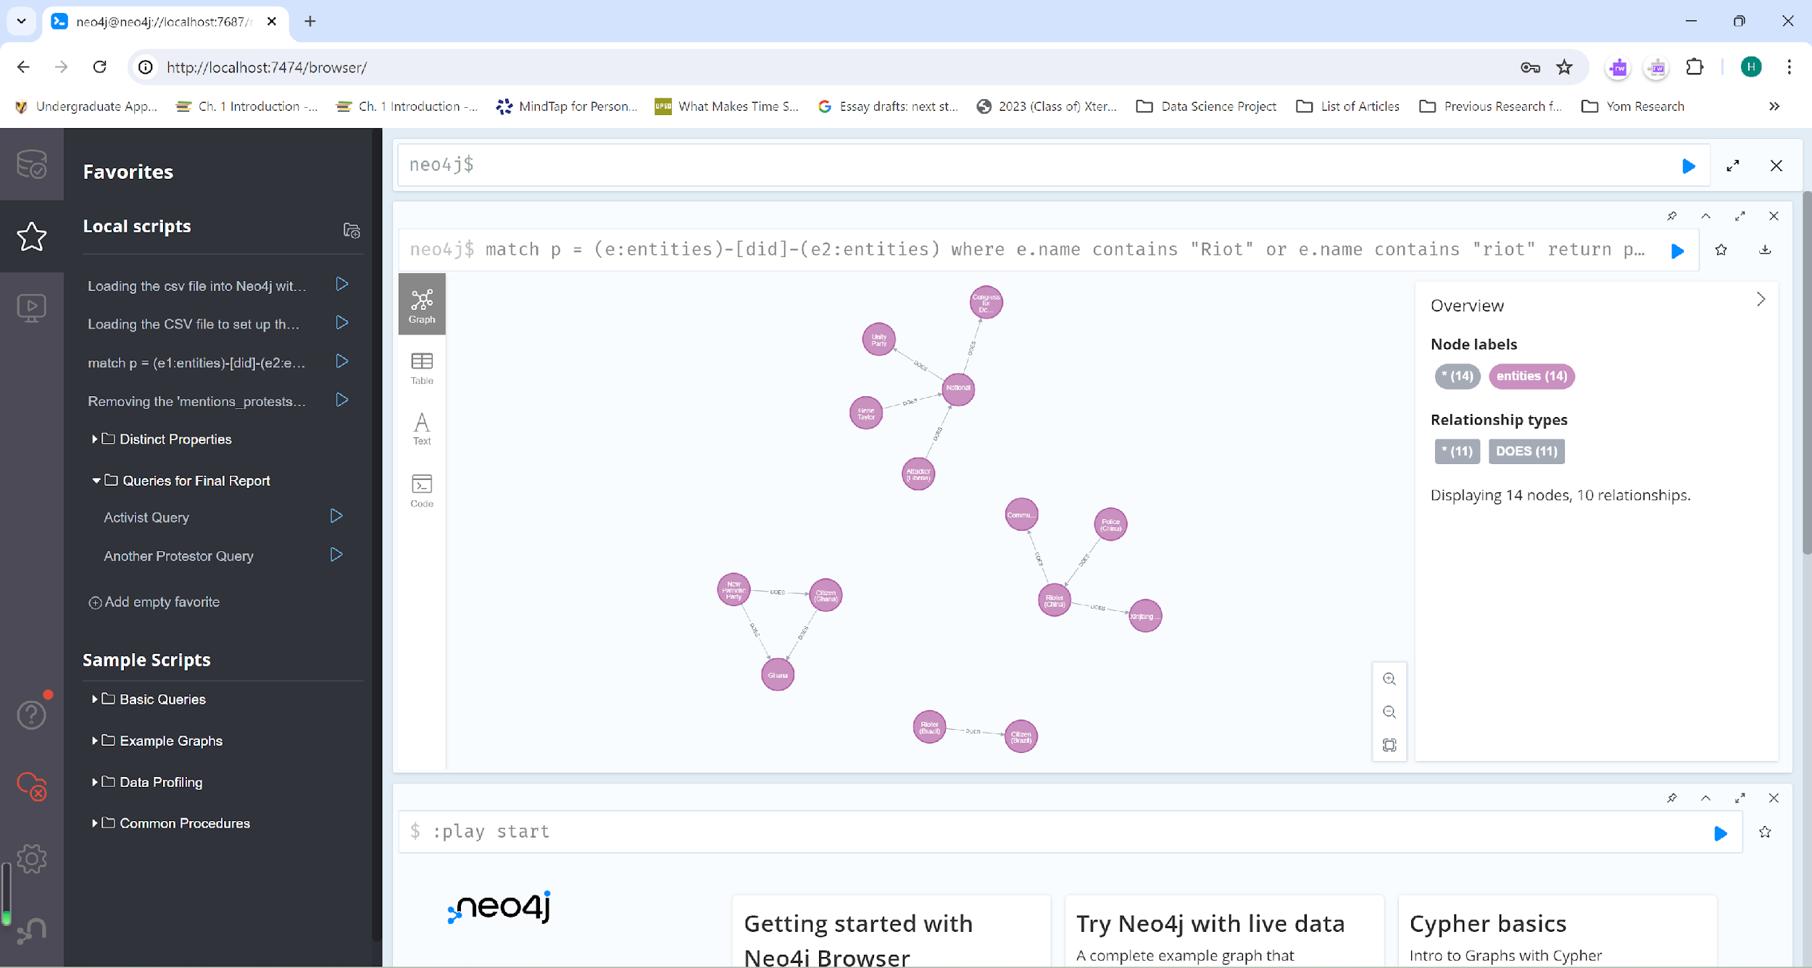
Examples of Findings of the 750,000 Rows-Version (Continued)
A picture of the Rioter Query with all rows loaded. Note that the rioter query will pick up nodes containing the word ‘riot’. Also note that the query has three more sub-queries.

Slide 13
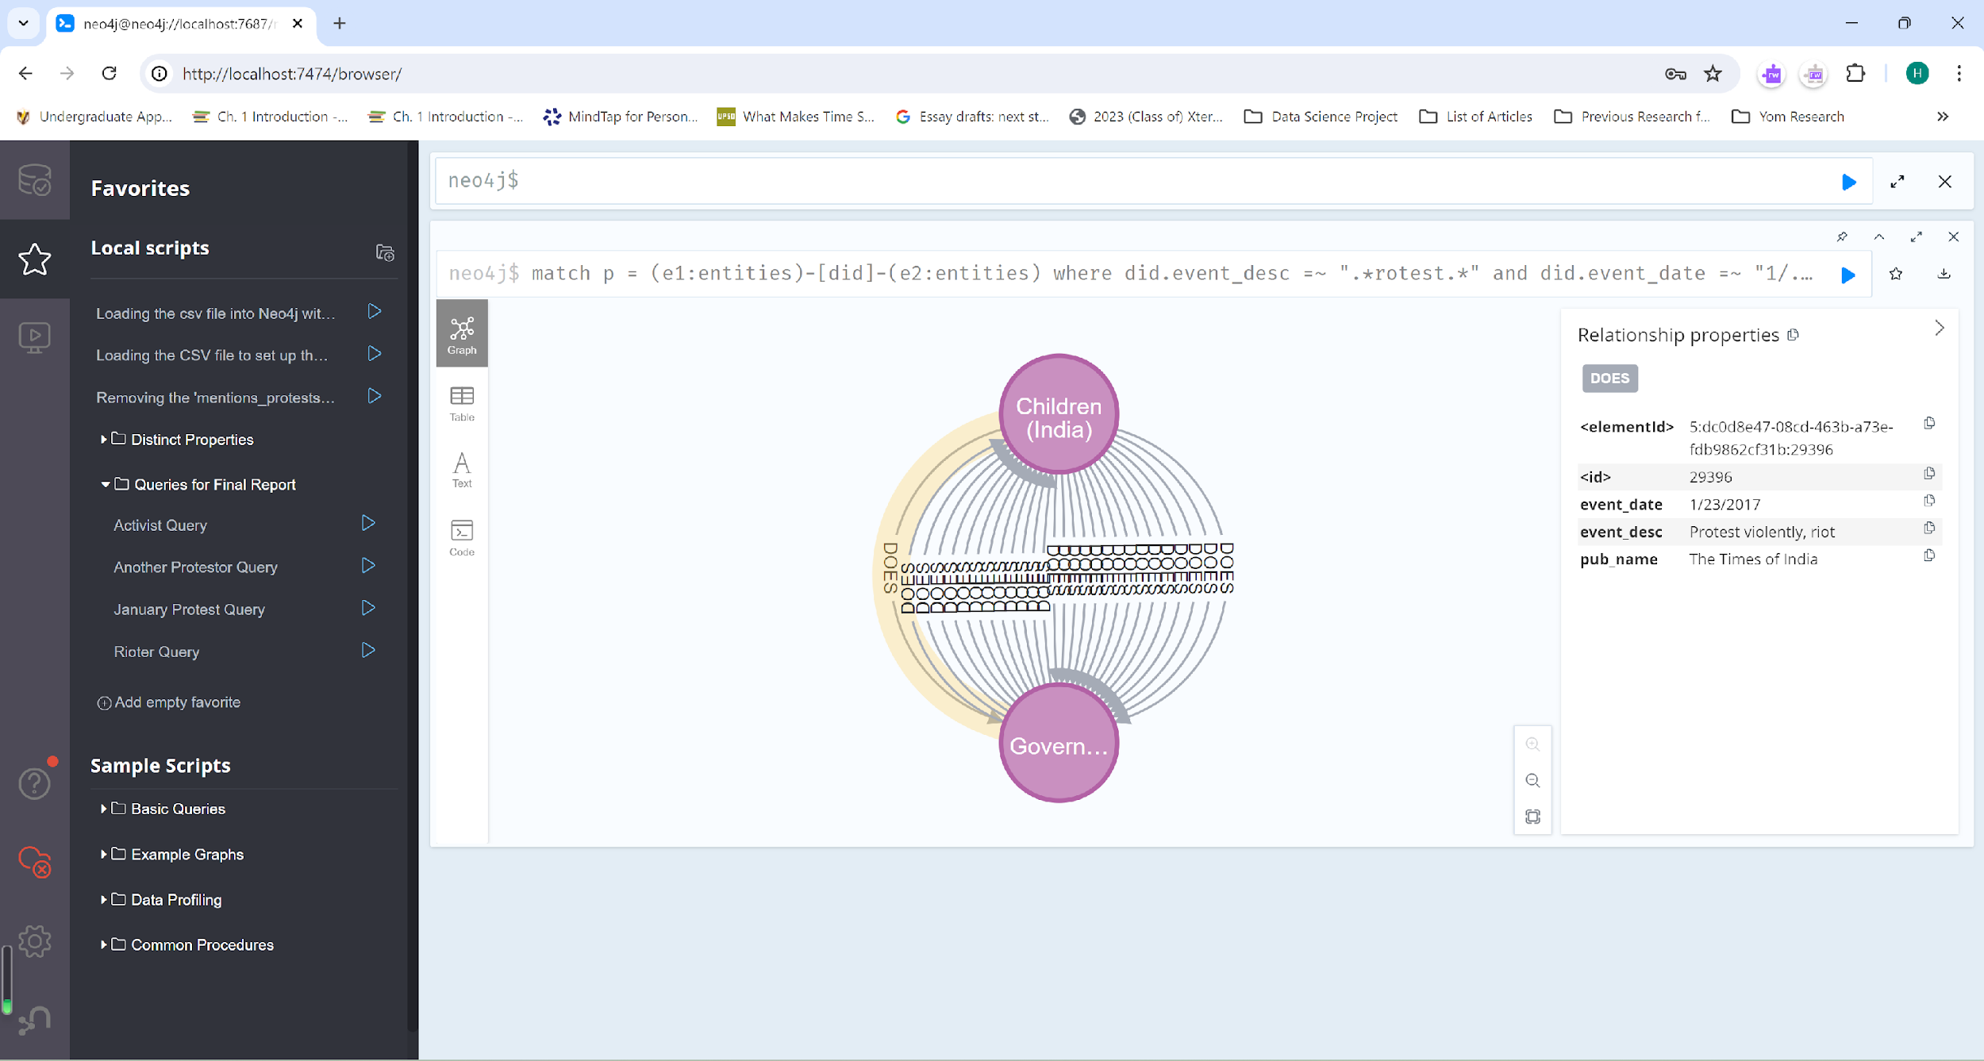
Examples of Findings of the 750,000 Rows-Version (Continued)
A screenshot of the recently-made query known as ‘January Protest Query’ with regex matching. This query will find if the relation’s event_desc and event_date match with the wildcard expressions: “.*rotest.*” and “1/.*”.

Slide 14
Summary
Temporal knowledge graphs are useful in detailing how relations between entities change over time.
We used Neo4j to observe political demonstrations from the ICEWS dataset based on TKGs.
We constructed the protest/non-protest labelling using Google Colab.

Slide 15
Future Work
Finish on implementing the protest/non-protest labelling on the CSV file of the ICEWS dataset for determining events that relate to protests.
First, use the Gensim’s GLOVE model to find first 50 similar words with a given word and the NLTK’s lemmatizer to return unique words without repeating words with the same base word (for example, protests and protested have the base word of protest).
Alternatively, we could use Spacy’s lemmatizer for more accurate list of unique words.
Then, use the openpyxl module to open the CSV file of the dataset and parse through each important row’s values and calculate the similarity between each word in a row and the word from the GLOVE model. The similarity value will be useful in classifying each event as either protest or non-protest if it is equal or above the threshold value.
Maybe attempt on using the t-nse for visualizing the non-protest events and protests.
Create a similarity score for each event and a bag-of-words related to protests.

Slide 16
Acknowledgements
Dr. Chunjiang Zhu (Department of Computer Science at UNCG) for advising
The NSF funding for this REU program in the University of North Carolina at Greensboro (UNCG)
My family as support

Slide 17
Citation
Li Cai, Xin Mao, Yuhao Zhou, et al., A Survey on Temporal Knowledge Graph: Representation Learning and Applications, Mar. 2024.
Jiabin Tang, Yuhao Yang, Wei Wei, et al., GraphGPT: Graph Instruction Tuning for Large Language Models, May 2024.
Wenqi Fan, Shijie Wang, Jiani Huang, et al., Graph Machine Learning in the Era of Large Language Models (LLMs), Apr. 2024.
Sahan S. Karatasli, Chunjiang Zhu, AI Integration to the Analysis of Youth Protests Using Digitized News Archive (Proposal), May 2024.
Neo4j, “Labels and Schema Indexes in Neo4j,” unknown date.

Slide 18
Thank You
Q&A

Slide 19
Demonstration with Updated Nodes and Relations
(IF TIME PERMITS)
(FEEL FREE TO OFFER SUGGESTIONS ON QUERIES)

